Slide 1

WAY TO ENTERPRISE
Java

Slide 2
Agenda
Collection & Map
Comparing
Generic
Assignments
Copyright © VTI Academy All Rights Reserved

Slide 3
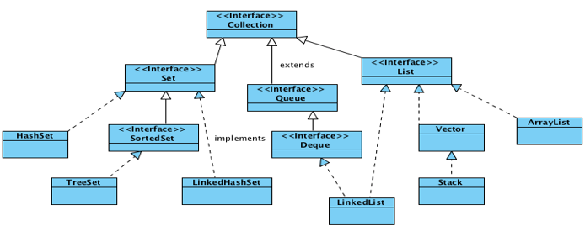
Collection
Array can manage objet or primitive
Collection can only manage object
Polymorphism

Slide 4
List
Type
  ArrayList
  Stack

Slide 5
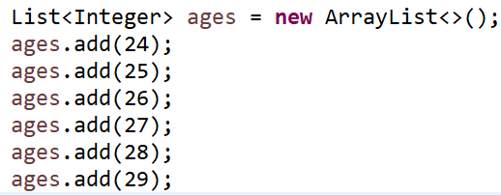
ArrayList
Init
Get Data

Slide 6
List’s Method
size()
get()
remove()
clear()

Slide 7
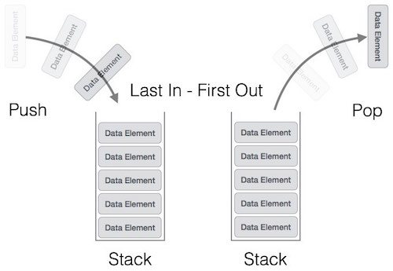
Stack
Methods
  pop()
  push()
  peek()
  isFull()
  isEmpty()

Slide 8
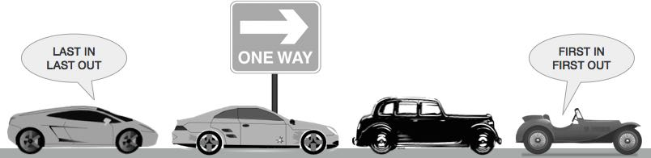
Queue
Methods
  enqueue()
  dequeue()
  peek()
  isFull()
  isEmpty()

Slide 9
Accessing by Index & neighborhood
Accessing by Index (Ex: ArrayList)
Accessing by neighbourhood (HashSet, LinkedList)

Slide 10
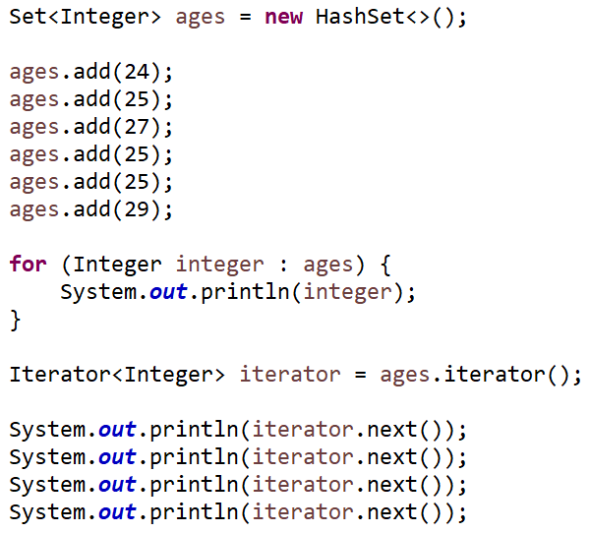
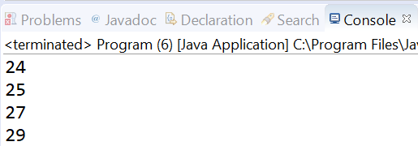
Set
Unique element

Slide 11
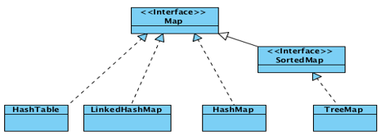
Map
Managing key-value

Slide 12
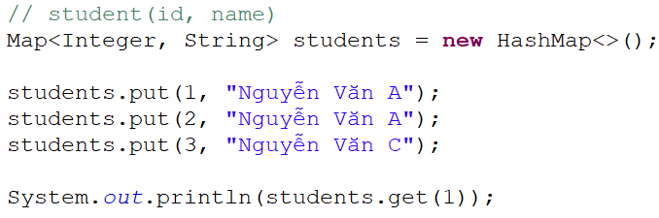
Example

Slide 13
Comparing
Equals()
Hashcode()
Comparable (1 criteria)
Comparator (multiple criteria)

Slide 14
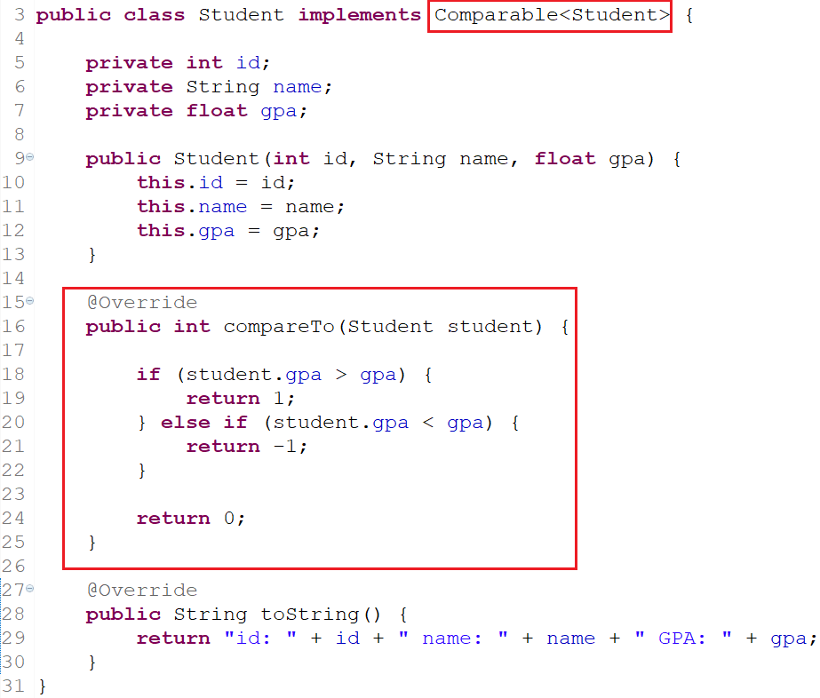
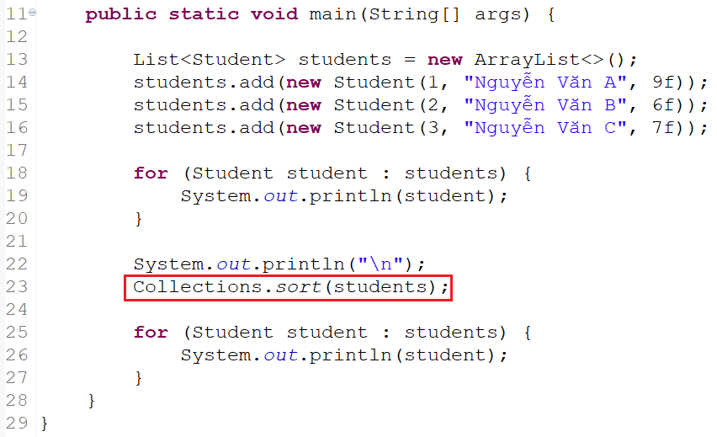
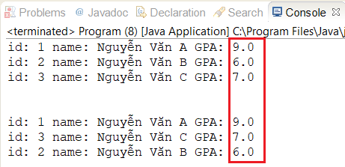
Comparable

Slide 15
Comparator

Slide 16
Generic
Common datatype as Object
Restrict
  Cannot init object which has T datatype
  Cannot using static
Type
  Class
  Method

Slide 17
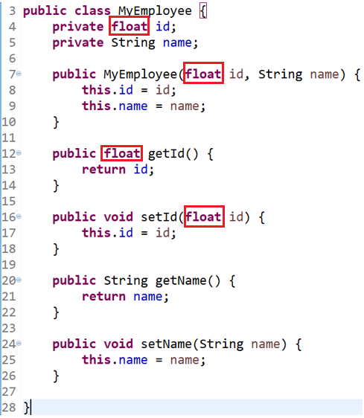
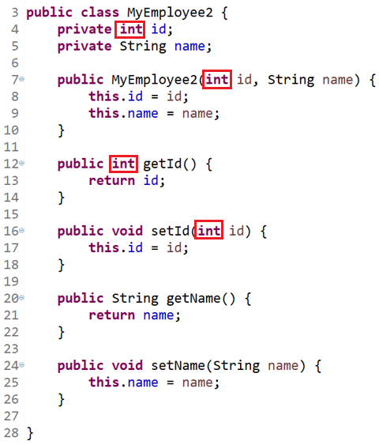
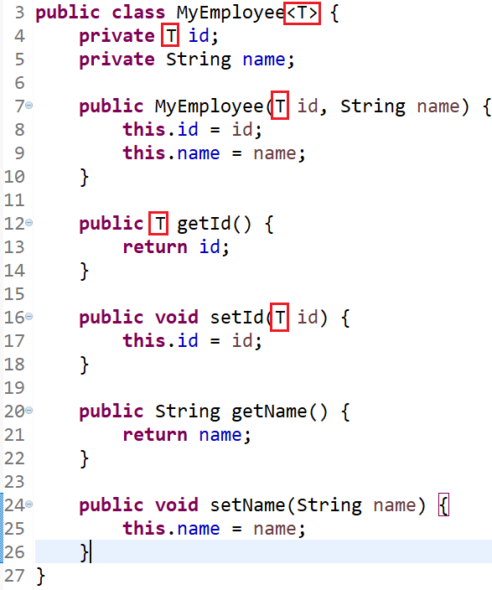
Generic For Class

Slide 18
Example
ArrayList, List

Slide 19
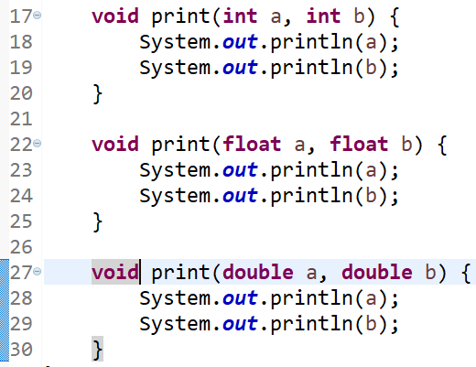
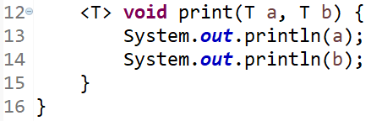
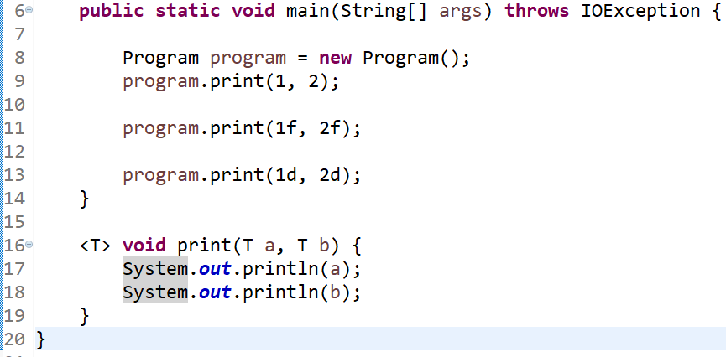
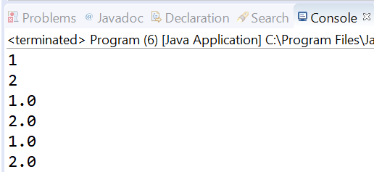
Generic for methods

Slide 20
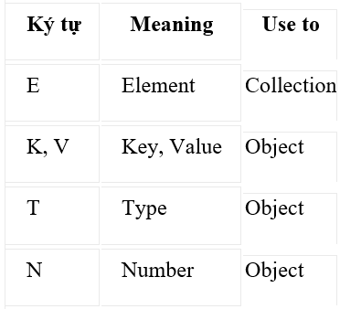
Generic

Slide 21
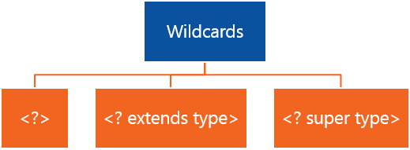
Wildcard

Slide 22
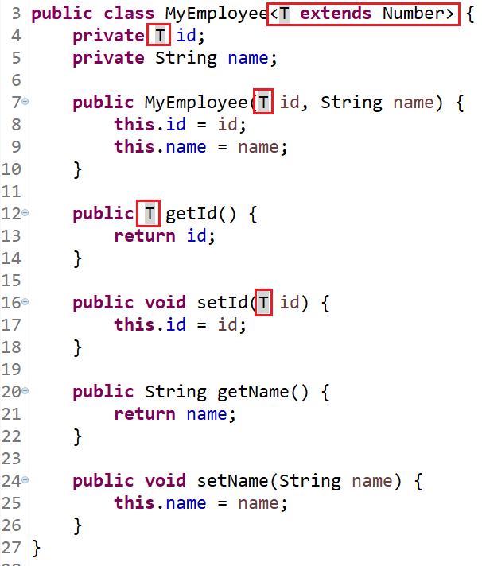
Example (class)

Slide 23
Q & A
Copyright © VTI Academy All Rights Reserved

